Slide 1

Insurance Fraud Analysis
By-
Manasi Jagdale
Varun Marthand
Bheem Prakash Mahipal Singh
Aditya Santosh Dhuri
Ashwin

Slide 2
Introduction
Bussiness Problem -
The Insurance Company has a need to develop capability that can help identify potential frauds with a high degree of accuracy.
Solution -
The solution should provide effictive way to identify the fraud claims so that other claims can be cleared rapidly while identified cases can be scrutinized in detail.

Slide 3
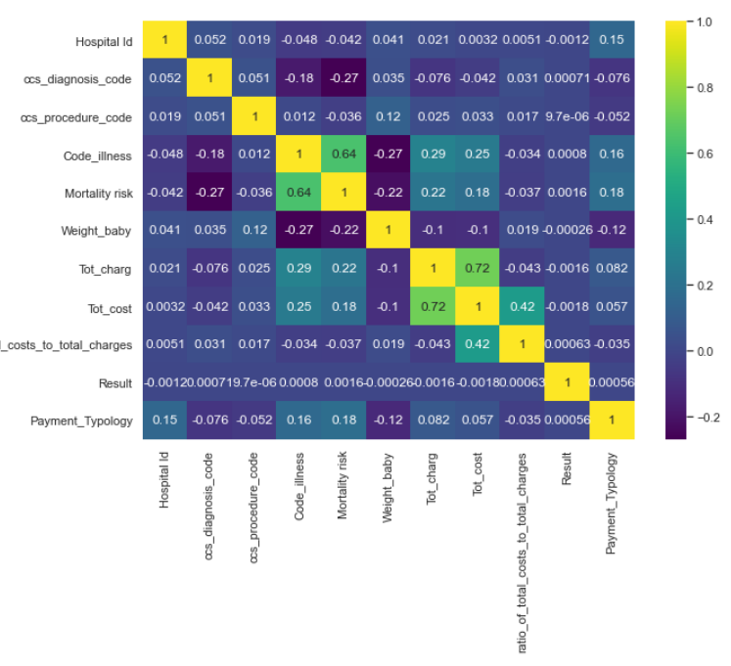
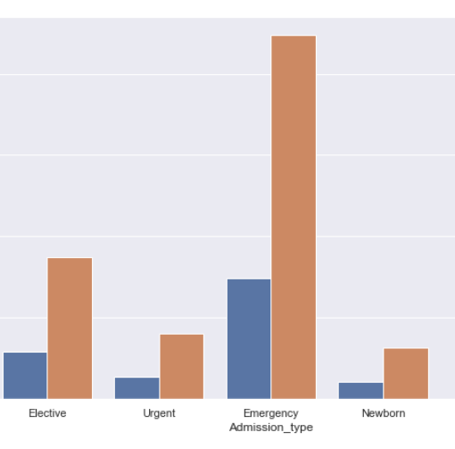
Data Facts and EDA
The data was collected mostly from New York regions. Data has some major attributes for fraud analysis like Total cost, area of the hospital, number of days spent in hospital, type of treatment given, etc.

Slide 4
Understanding Our Data-
There were total 23 Attributes and 1048575 records in our data for Analysis.
Amongst which we had 0.78% ie. 4814 duplicate records and 0.235% of Null values in 4 columns namely Area Service, Hospital County, Hospital ID and Mortality Risk. Hence, we decided to drop them.
Our Data consisted of 13 Categorical – Area of Service ,Hospital County, Age, Gender, Cultural group, ethnicity, Days spent in hospital, Admission type, Home or self care, Drug description, Surgery Description, Abortion, Emergency

Slide 5
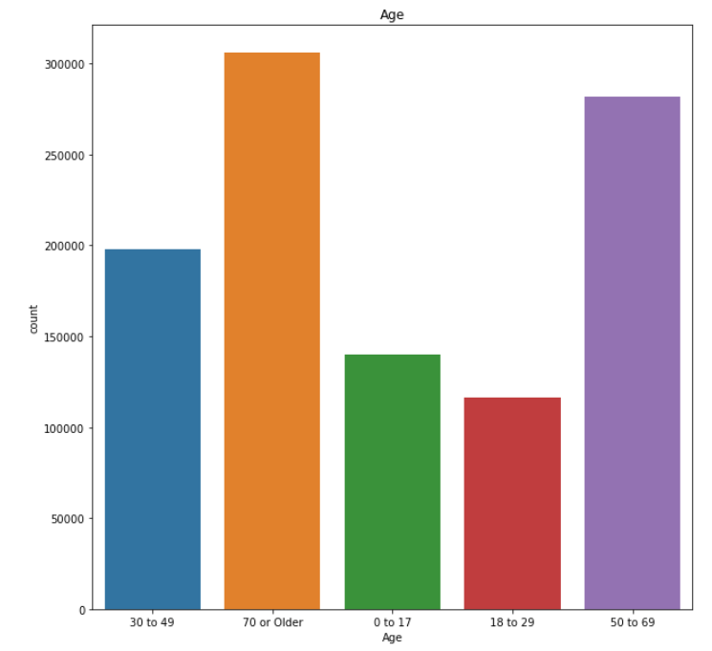
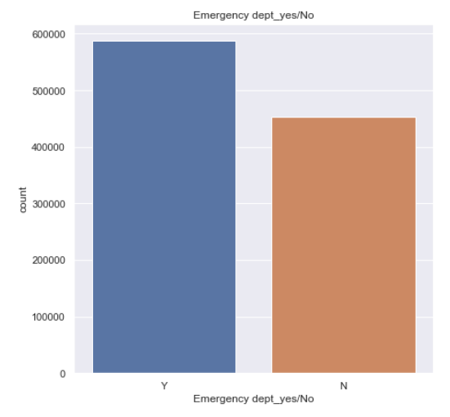
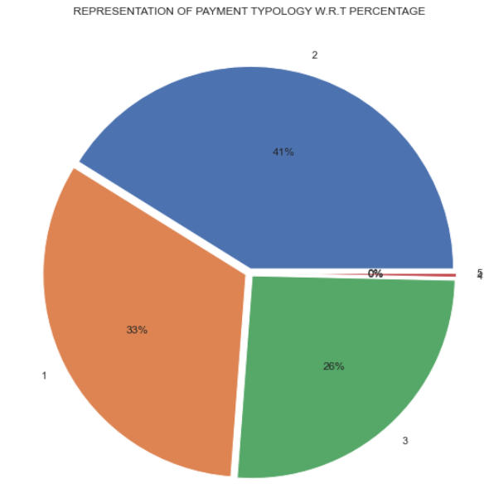
Univariate Data Analysis-

Slide 6
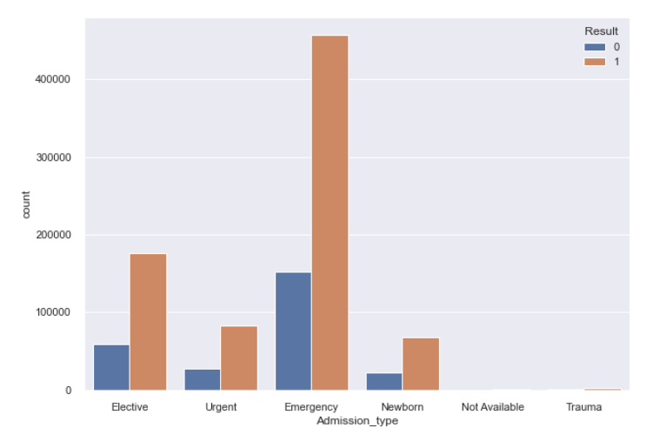
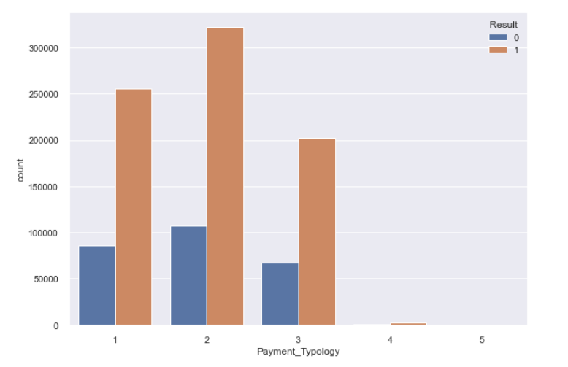
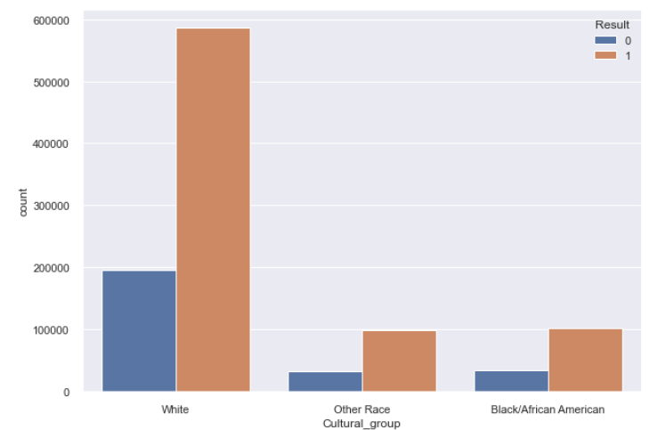
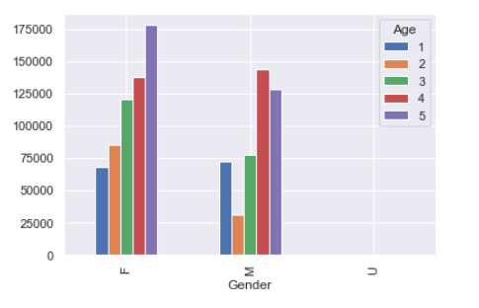

Slide 7
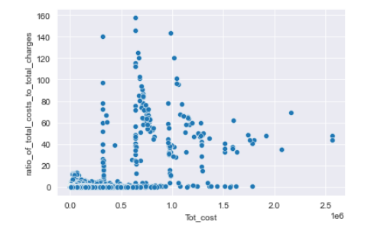
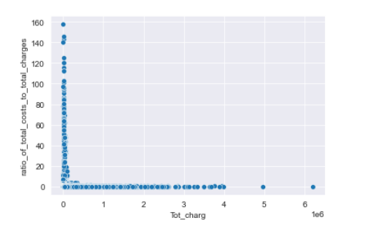
11 Numerical Columns - Hospital Id, ccs diagnosis code, ccs procedure code, Code illness, Mortality risk, Weight of baby, Total charge, Total cost, ratio of total costs to total charges, Payment Type

Slide 8
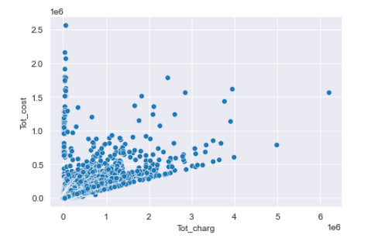
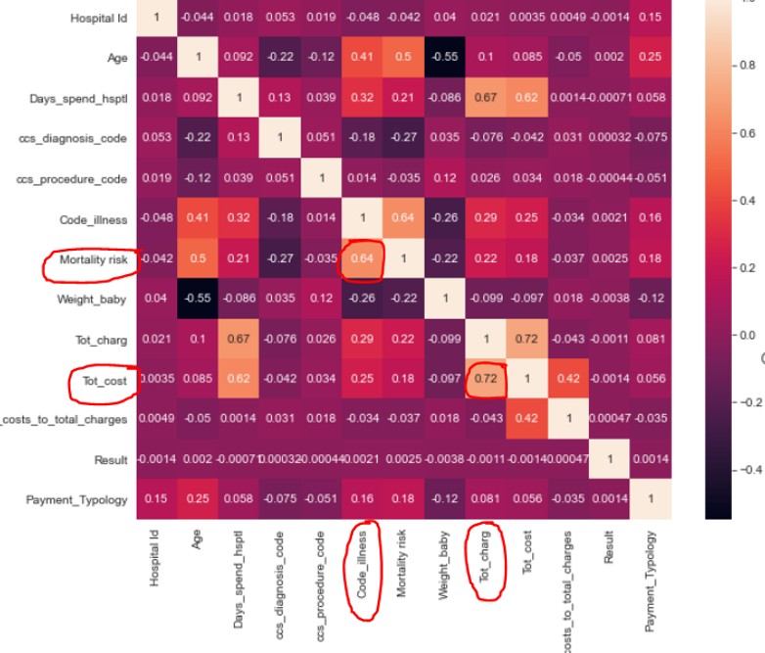
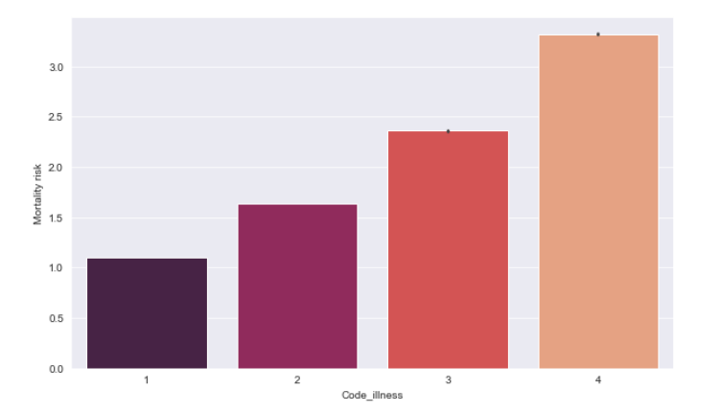
Correlation
While conducting EDA Slight Correlation was found –
Total Charge and Total Cost – 0.72
Code Illness and Mortality Risk – 0.64

Slide 9
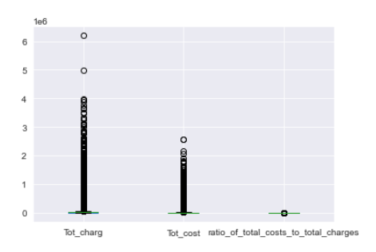
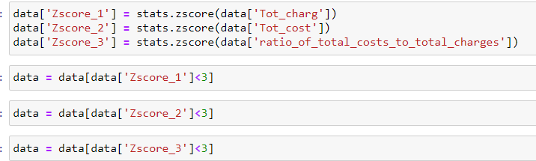
Outlier Treatment-
We detected outliers in Total cost, Total Charge and Total cost to charge ratio we decided to go for Z-score method to treat Outliers.

Slide 10
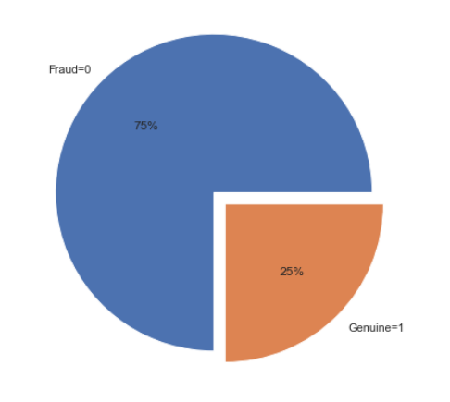
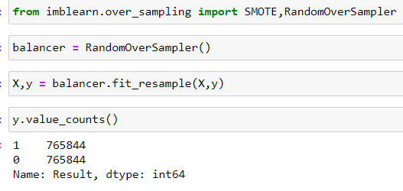
Data Balancing
Our data was highly imbalanced w.r.t Result - our Dependent Variable–
75% ie. 780361 Fraud(0) Records and 25% ie 260904 Genuine(1) Records
Hence using Random OverSampler method we balanced our data in 50-50%

Slide 11
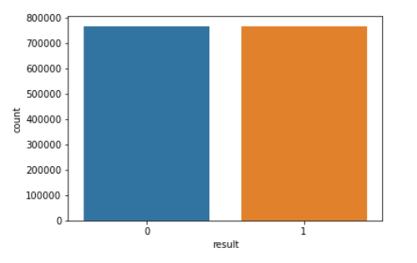
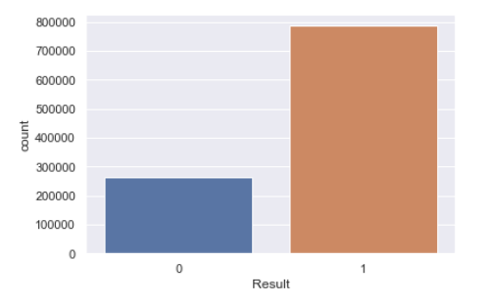


Balancing Data
As we can see, our data was highly skewed.
Hence we opted for Random Over Sampling Technique.

Slide 12
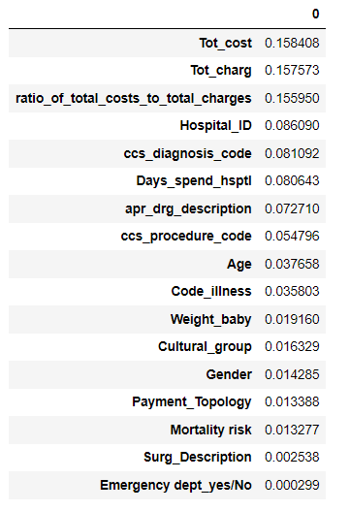
Feature Selection
We filtered out some Features of our data using Extra Trees Classifier.
The Final 14 Features we selected for our model building were-
Age, Gender, Days spent in hospital', ccs_diagnosis_code, ccs_procedure_code, apr_drg_description, Code_illness, Mortality risk, Weight_baby, Emergency, Tot_charg, Tot_cost, ratio_of_total_costs_to_total_charge,Payment_Typology.

Slide 13
Model Comparison
Accuracy | Logistic Regression | Decision Tree | Random Forest
Training | 90 | 95 | 99
Test | 51 | 78 | 88

Slide 14
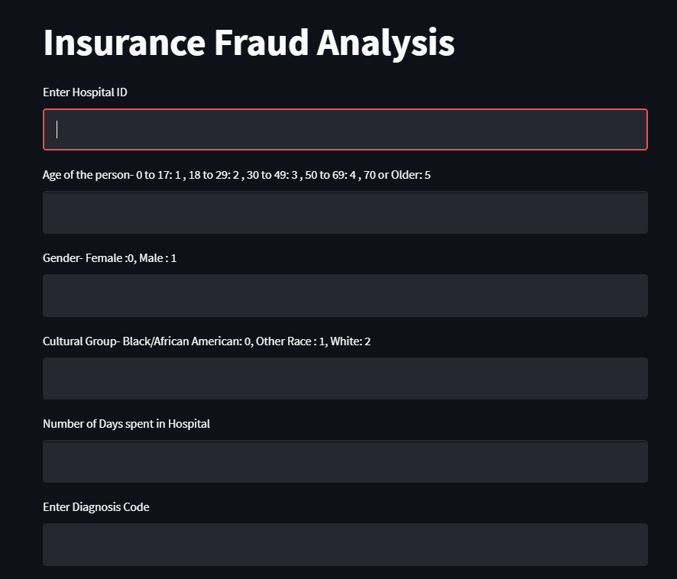
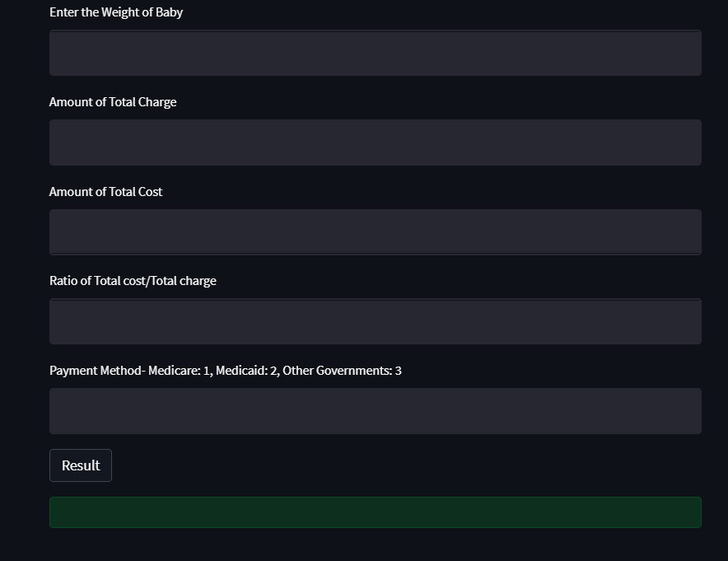
Deployment
We've completed the last step of our project that is Deployment using STREAMLIT.

Slide 15
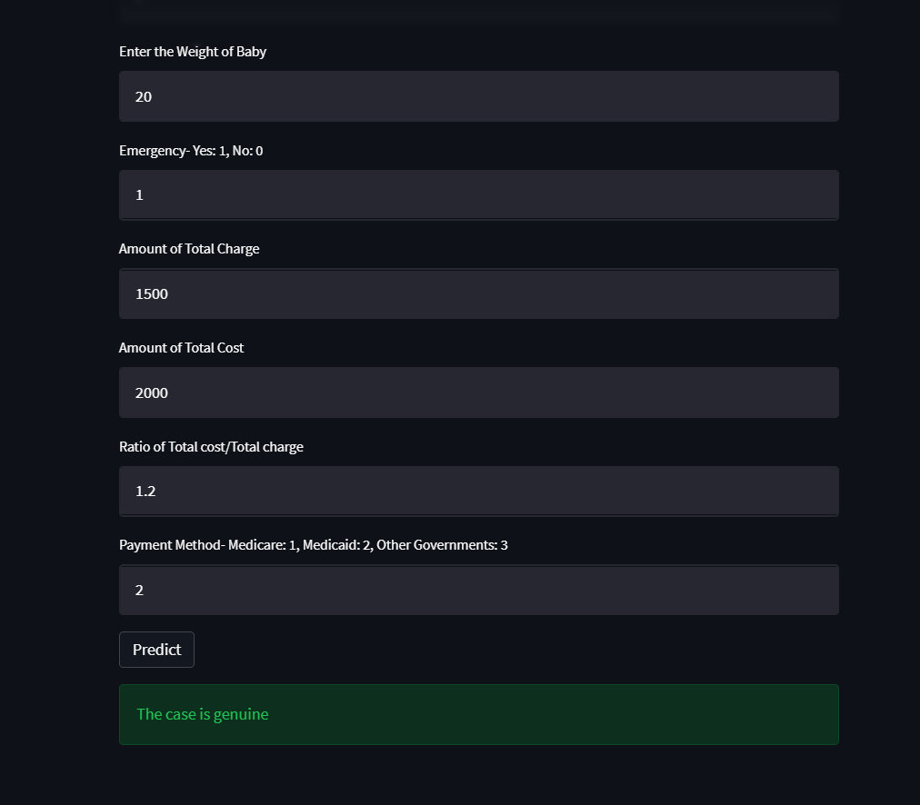
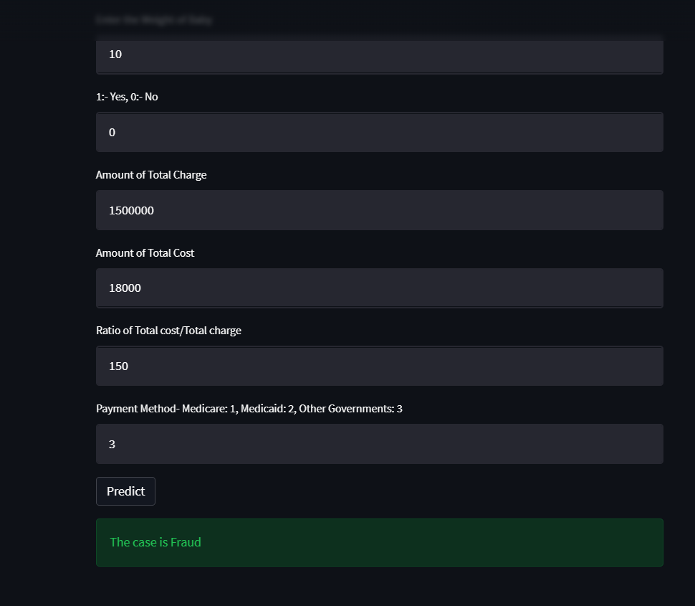

Slide 16




Conclusion
The intention is to encourage antifraud managers to use proactive data detection techniques in order to improve fraud prevention and detection.
The process of data analysis as a tool for preventing and detecting fraud can be used successfully in any field, especially in those where database are, or, may be easily converted into electronic format.

